Slide 1

Module 5
Tree-Based Models
Notes:
Guidelines
Use section headers to chunk content in your presentation.
Use the same style of section header throughout your presentation.
Keep your title to no more than 2 lines.

Slide 2
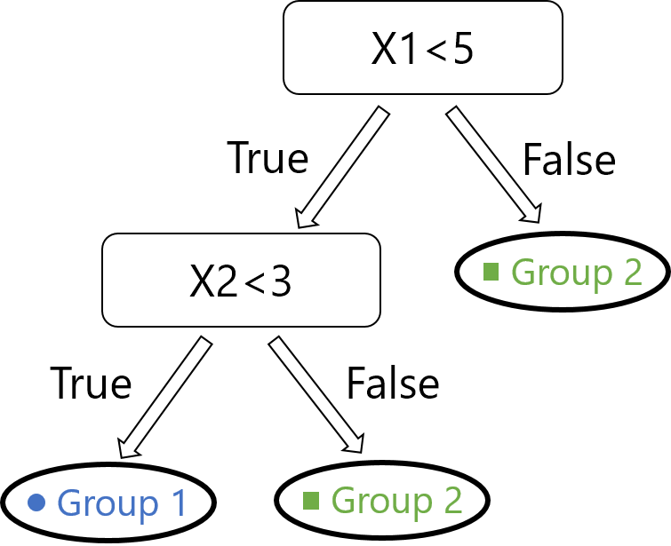
Decision/Regression Trees Recursive Partitioning and Impurity
Notes:
Guidelines
Use a title slide at the beginning of your presentation. There are 9 variations of title slides to choose from.
If you will have a series of slideshows, we recommend using the same style of title slide for each presentation.
Keep your title to no more than 2 lines.
Do not change the font style or font size of the title or subtitle.

Slide 3
Trees are Rules-Based Algorithms
Goal: Classify or predict an outcome based on a set of predictors
Example of Rule for Tree Below:
1) IF (X1 < 5) AND (X2 < 3) THEN Class = “Group 1”
2) IF (X1 < 5) AND (X2 >= 3) THEN Class = “Group 2”
3) IF (X1 >= 5) THEN Class = “Group 2”

Slide 4
Decision Trees
Also called CART, Decision Trees, or just Trees
Rules are represented by tree diagrams,
Trees are internally coded as rules (IF … THEN … ELSE)
Predictions (y_pred) are the most common class in the node
Propensities (p_hat) are based on the ratios of each class

Slide 5
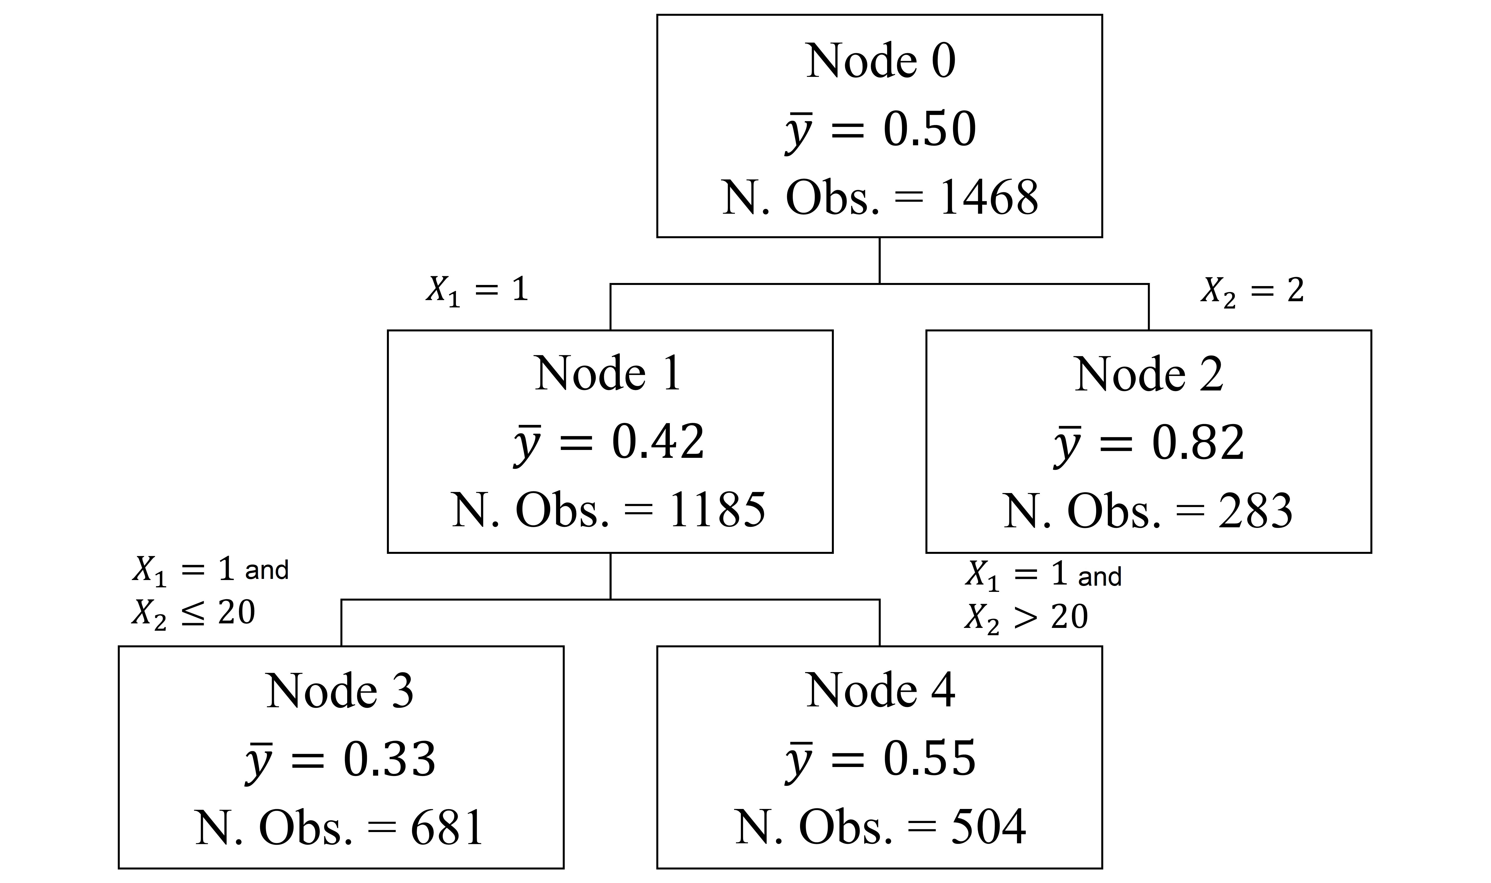
Regression Trees
Also called decision tree regressors
Regression trees also use rules (IF … THEN … ELSE)
Rules are represented by tree diagrams
Predictions (y_pred) are the averages of y on the node
1) IF (X1 = 1) AND X2 <= 20 THEN prediction = 0.33
2) IF (X2 = 1) AND (X2 > 20) THEN prediction = 0.55
3) IF (X2 = 2) THEN prediction = 0.82

Slide 6
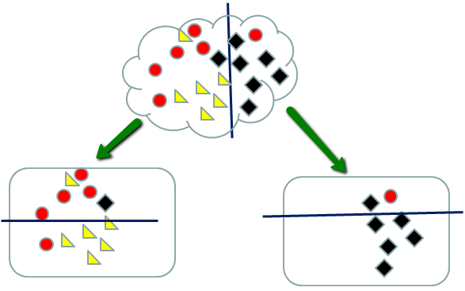
Recursive Partitioning
Repeatedly split the nodes into two parts to decrease impurity
Stop when no more impurity or stopping rule triggered

Slide 7
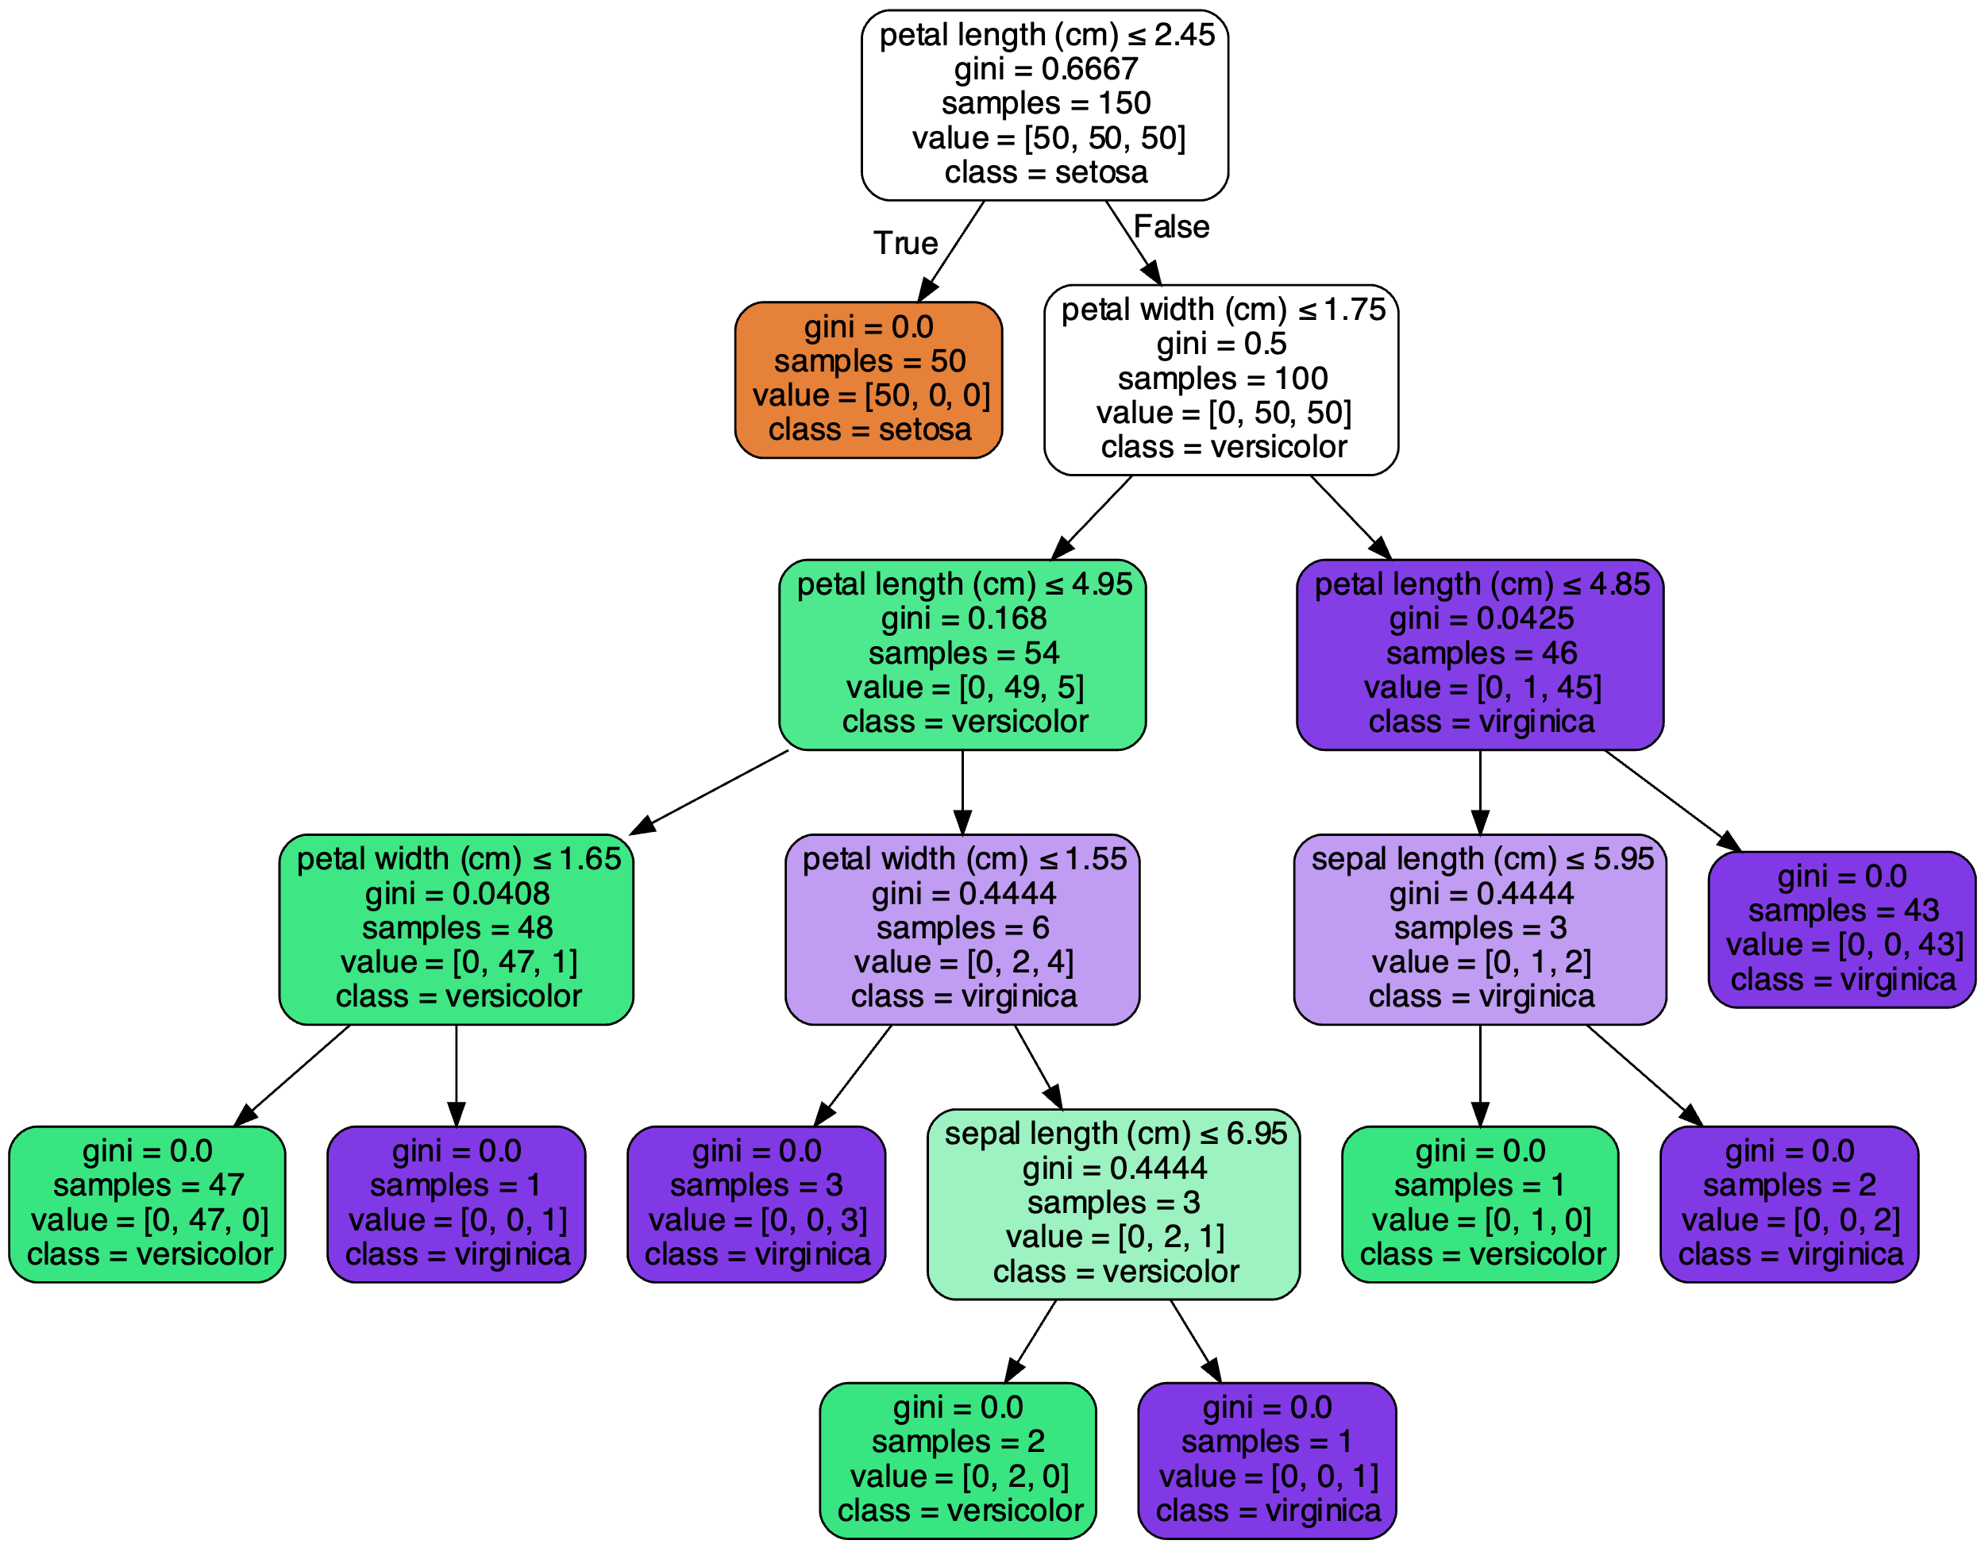
Recursive Partitioning
Repeatedly split the nodes into two parts to decrease impurity
Stop when no more impurity or stopping rule triggered
stopping rule triggered

Slide 8
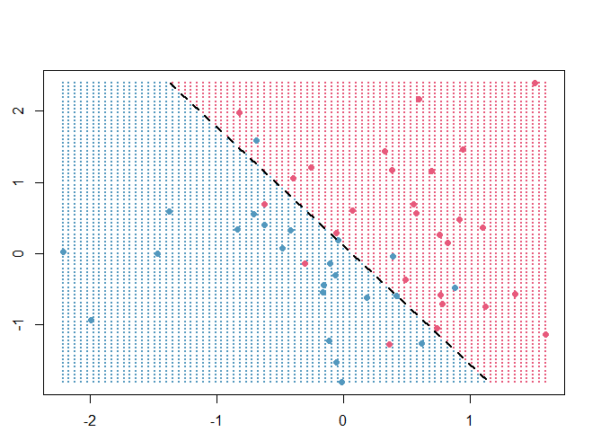
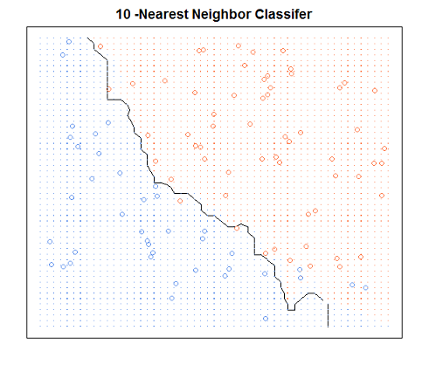
Decision Boundary
A line or curve that separates different groups of data points
Classification models produce linear or non-linear boundaries
X₂
X₂
X₁
X₁

Slide 9
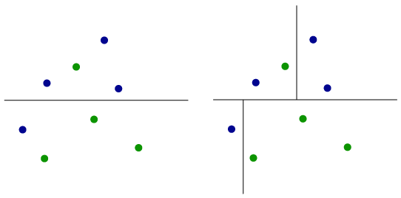
Decision Tree Boundaries
Determined by overlapping orthogonal half-planes
Each split creates represents a subsequent decision
X₂
X₂
X₁
X₁

Slide 10
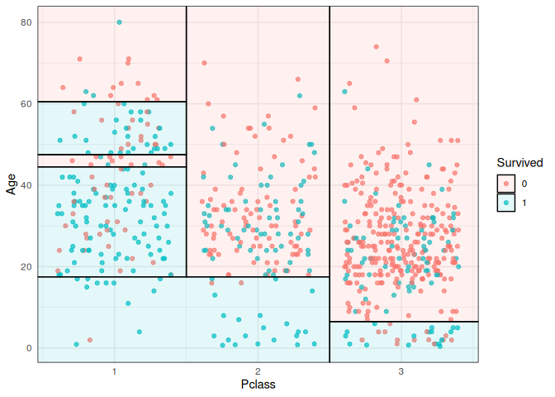
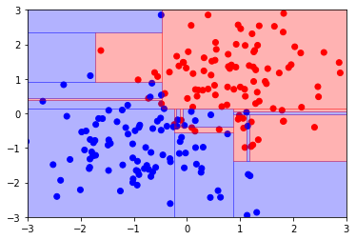
Decision Tree Boundaries
Determined by overlapping orthogonal half-planes
X₂
X₂
X₁
X₁

Slide 11
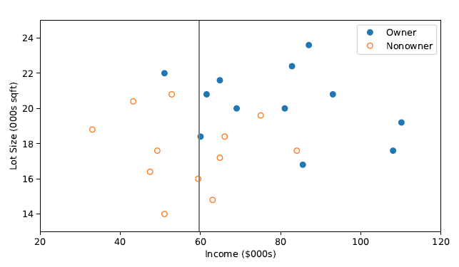
How to Measure Impurity
There are some metrics we can use
Gini Index (Classification)
Entropy (Classification)
RMSE (Regression)
These metrics are computed at each node for ALL possible splits

Slide 12
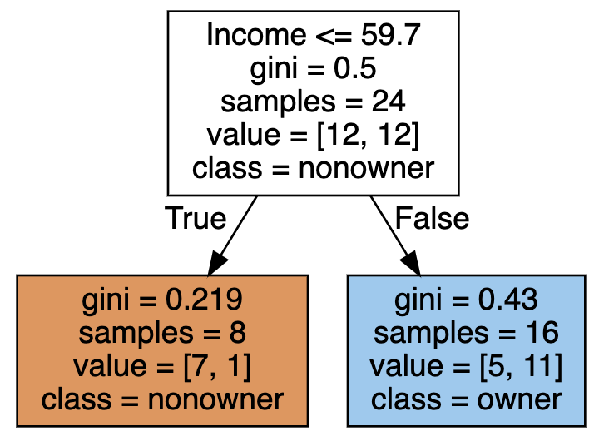
How to Measure Impurity
There are some metrics we can use
Gini Index (Classification)
Entropy (Classification)
RMSE (Regression)
These metrics are computed at each node for ALL possible splits

Slide 13
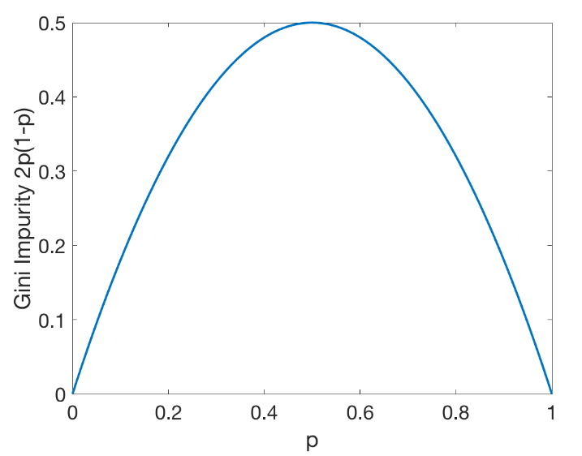
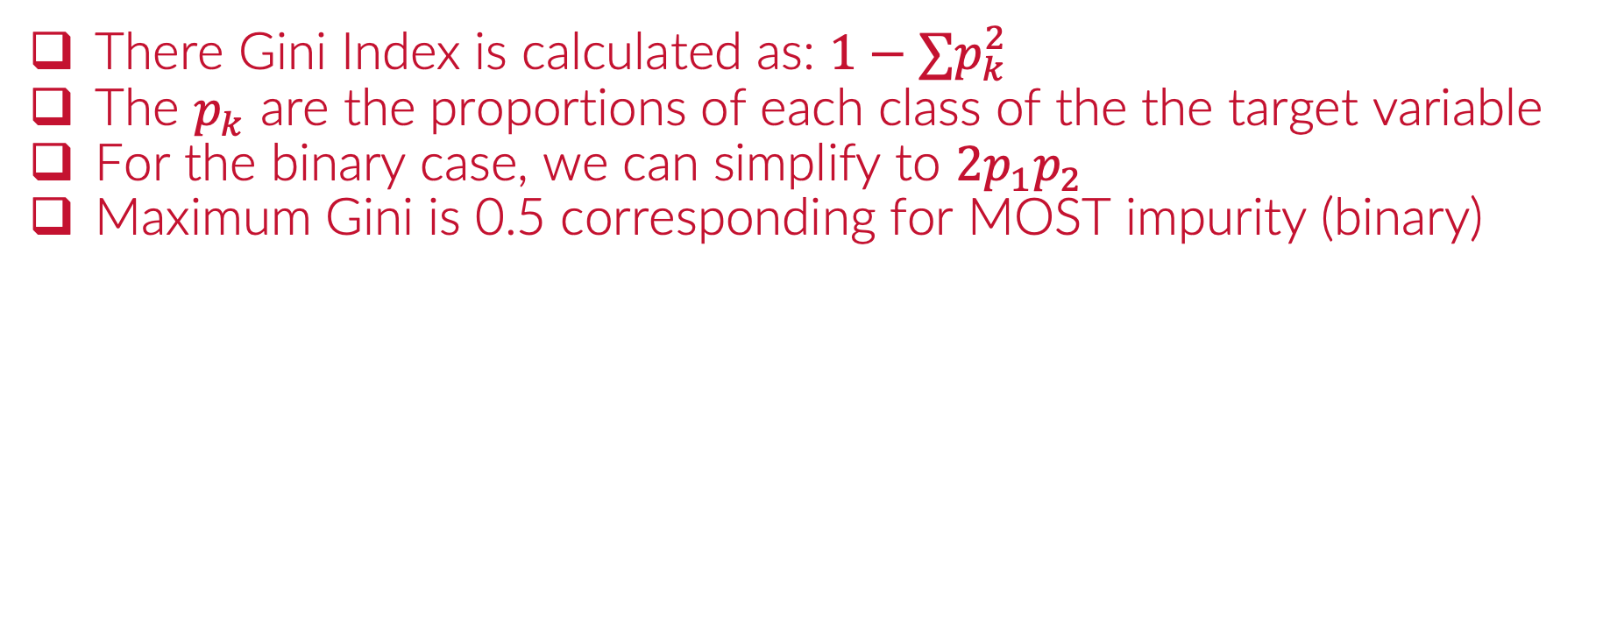
The Gini Index (Classification)
There Gini Index is calculated as: $1−∑p_{k}^{2}$
The $p_{k}$ are the proportions of each class of the the target variable
For the binary case, we can simplify to $2p_{1}p_{2}$
Maximum Gini is 0.5 corresponding for MOST impurity (binary)

Slide 14
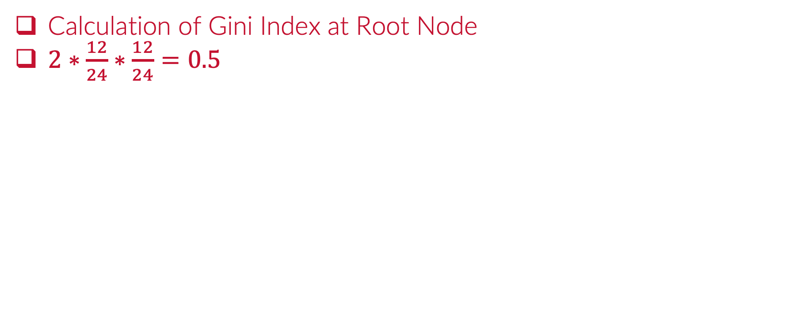
The Gini Index (Root Node)
Calculation of Gini Index at Root Node
$2∗\frac{12}{24}∗\frac{12}{24}=0.5$

Slide 15
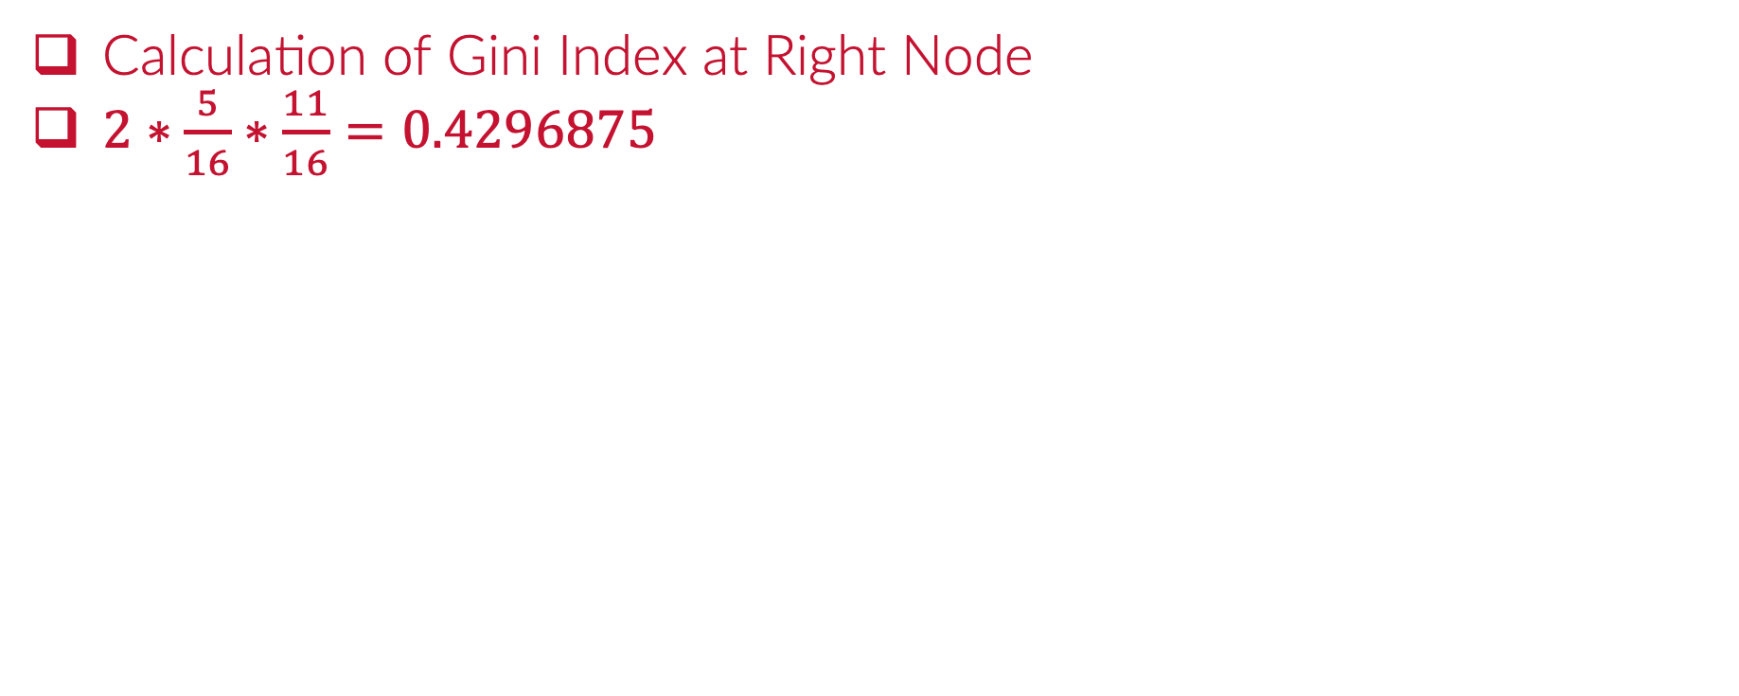
The Gini Index (Right Node)
Calculation of Gini Index at Right Node
$2∗\frac{5}{16}∗\frac{11}{16}=0.4296875$

Slide 16
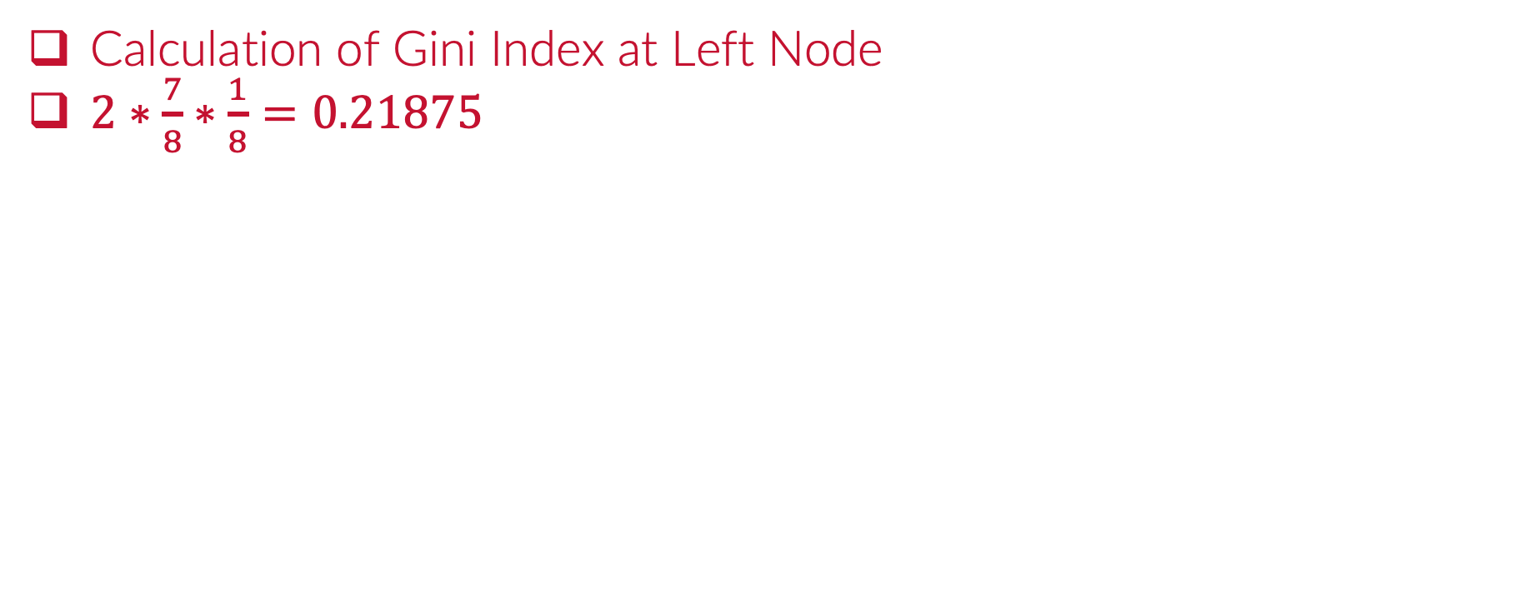
The Gini Index (Left Node)
Calculation of Gini Index at Left Node
$2∗\frac{7}{8}∗\frac{1}{8}=0.21875$

Slide 17



Please download and install the Slido app on all computers you use
What is the GINI index for the following node?
ⓘ Start presenting to display the poll results on this slide.

Slide 18
Please download and install the Slido app on all computers you use
Which node has the highest GINI Index
ⓘ Start presenting to display the poll results on this slide.

Slide 19
Please download and install the Slido app on all computers you use
What is the GINI Index on this node?
ⓘ Start presenting to display the poll results on this slide.

Slide 20
Please download and install the Slido app on all computers you use
What is the GINI index in this multi-class node?
ⓘ Start presenting to display the poll results on this slide.

Slide 21
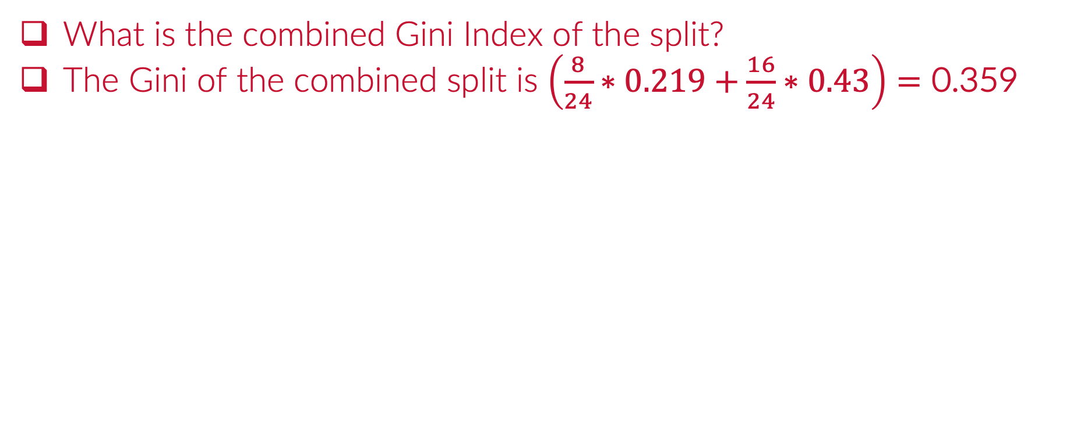
The Gini Index of a Split
What is the combined Gini Index of the split?
The Gini of the combined split is $\left(\frac{8}{24}∗0.219+\frac{16}{24}∗0.43\right)=\text{0.359}$

Slide 22
Please download and install the Slido app on all computers you use
What is the Combined GINI of the split?
ⓘ Start presenting to display the poll results on this slide.

Slide 23
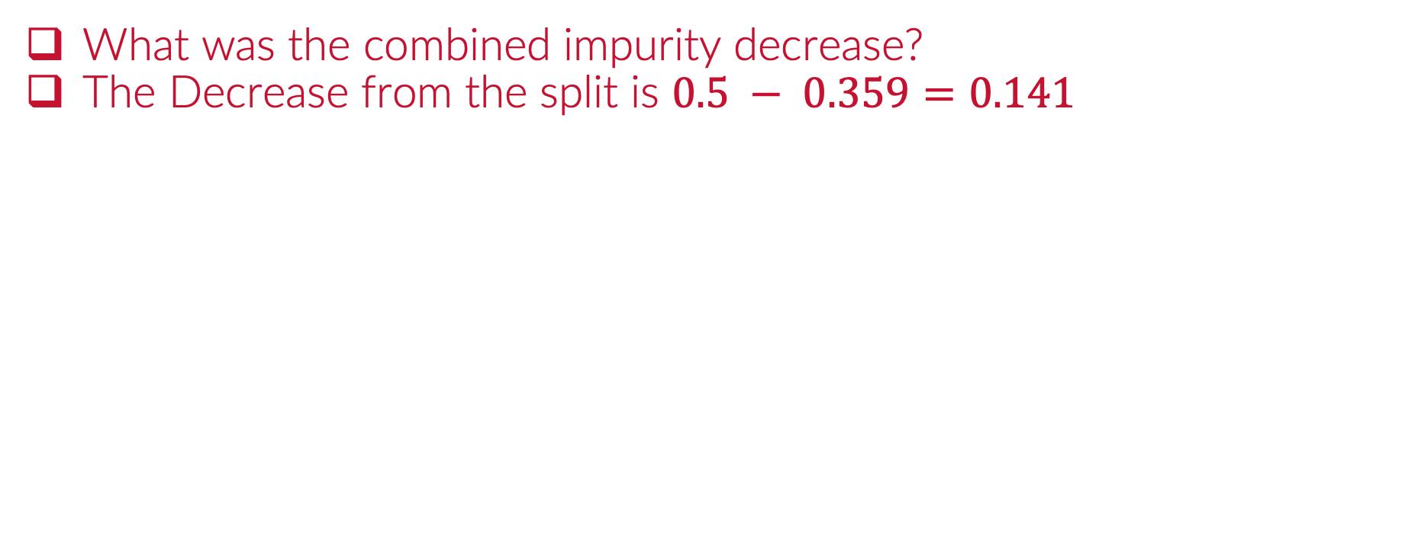
The Gini Improvement of a Split
What was the combined impurity decrease?
The Decrease from the split is $0.5 − 0.359=0.141$

Slide 24
Please download and install the Slido app on all computers you use
What is the GINI improvement (impurity decrease)?
ⓘ Start presenting to display the poll results on this slide.

Slide 25
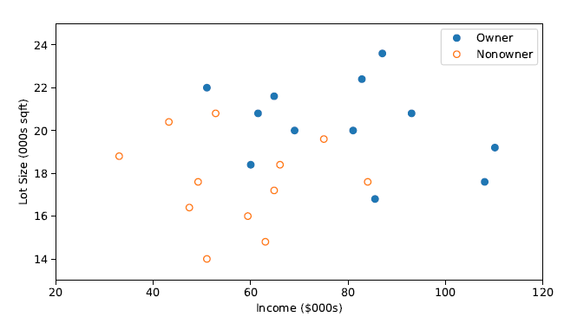
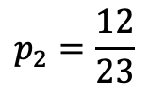
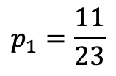
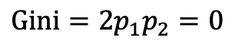
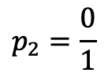
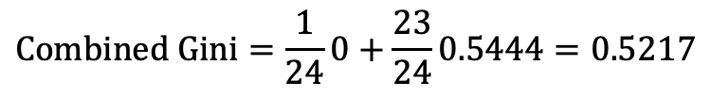
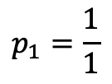
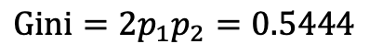
The Gini Index
These Gini Index is computed at each node for ALL possible splits
$$p_{1}=\frac{1}{1}$$
$$p_{2}=\frac{0}{1}$$
$$Gini=2p_{1}p_{2}=0$$
$$p_{1}=\frac{11}{23}$$
$$p_{2}=\frac{12}{23}$$
$$Gini=2p_{1}p_{2}=0.5444$$
$$Combined Gini=\frac{1}{24}0+\frac{23}{24}0.5444=0.5217$$
$$\text{impurity} \text{decrease} \text{= 0.5 – 0.5217 = -0.0217}$$

Slide 26
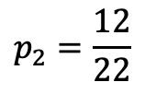
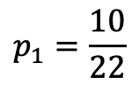
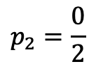
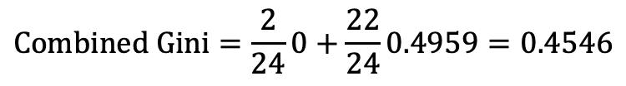
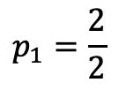
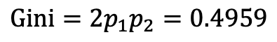
The Gini Index
These Gini Index is computed at each node for ALL possible splits
$$p_{1}=\frac{2}{2}$$
$$p_{2}=\frac{0}{2}$$
$$Gini=2p_{1}p_{2}=0$$
$$p_{1}=\frac{10}{22}$$
$$p_{2}=\frac{12}{22}$$
$$Gini=2p_{1}p_{2}=0.4959$$
$$Combined Gini=\frac{2}{24}0+\frac{22}{24}0.4959=0.4546$$
$$\text{impurity} \text{decrease} \text{= 0.5 –} 0.4546 \text{=} \text{0.0454}$$

Slide 27
The Gini Index
These Gini Index is computed at each node for ALL possible splits

Slide 28
The Gini Index
These Gini Index is computed at each node for ALL possible splits

Slide 29
The Gini Index
These Gini Index is computed at each node for ALL possible splits

Slide 30
The Gini Index
These Gini Index is computed at each node for ALL possible splits

Slide 31
The Gini Index
These Gini Index is computed at each node for ALL possible splits

Slide 32
The Gini Index
These Gini Index is computed at each node for ALL possible splits

Slide 33
The Gini Index
These Gini Index is computed at each node for ALL possible splits

Slide 34
The Gini Index
These Gini Index is computed at each node for ALL possible splits

Slide 35
The Gini Index
These Gini Index is computed at each node for ALL possible splits

Slide 36
The Gini Index
These Gini Index is computed at each node for ALL possible splits

Slide 37
The Gini Index
These Gini Index is computed at each node for ALL possible splits

Slide 38
The Gini Index
These Gini Index is computed at each node for ALL possible splits

Slide 39
The Gini Index
These Gini Index is computed at each node for ALL possible splits

Slide 40
The Gini Index
These Gini Index is computed at each node for ALL possible splits

Slide 41
The Gini Index
These Gini Index is computed at each node for ALL possible splits

Slide 42
The Gini Index
These Gini Index is computed at each node for ALL possible splits
$$Gini Index Improvement 0.141$$

Slide 43
Python
Notes:
Guidelines
Use a title slide at the beginning of your presentation. There are 9 variations of title slides to choose from.
If you will have a series of slideshows, we recommend using the same style of title slide for each presentation.
Keep your title to no more than 2 lines.
Do not change the font style or font size of the title or subtitle.

Slide 44
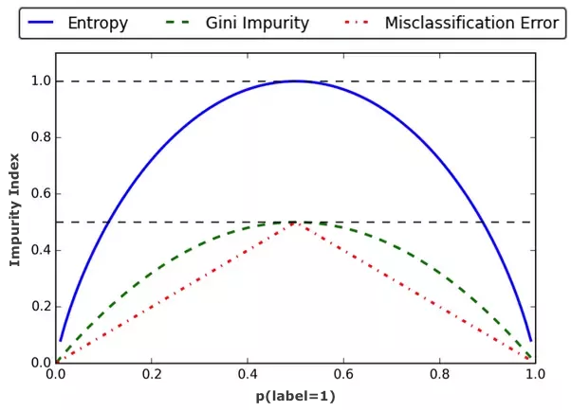
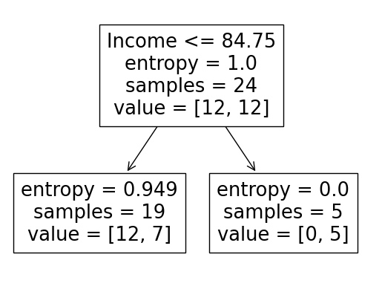
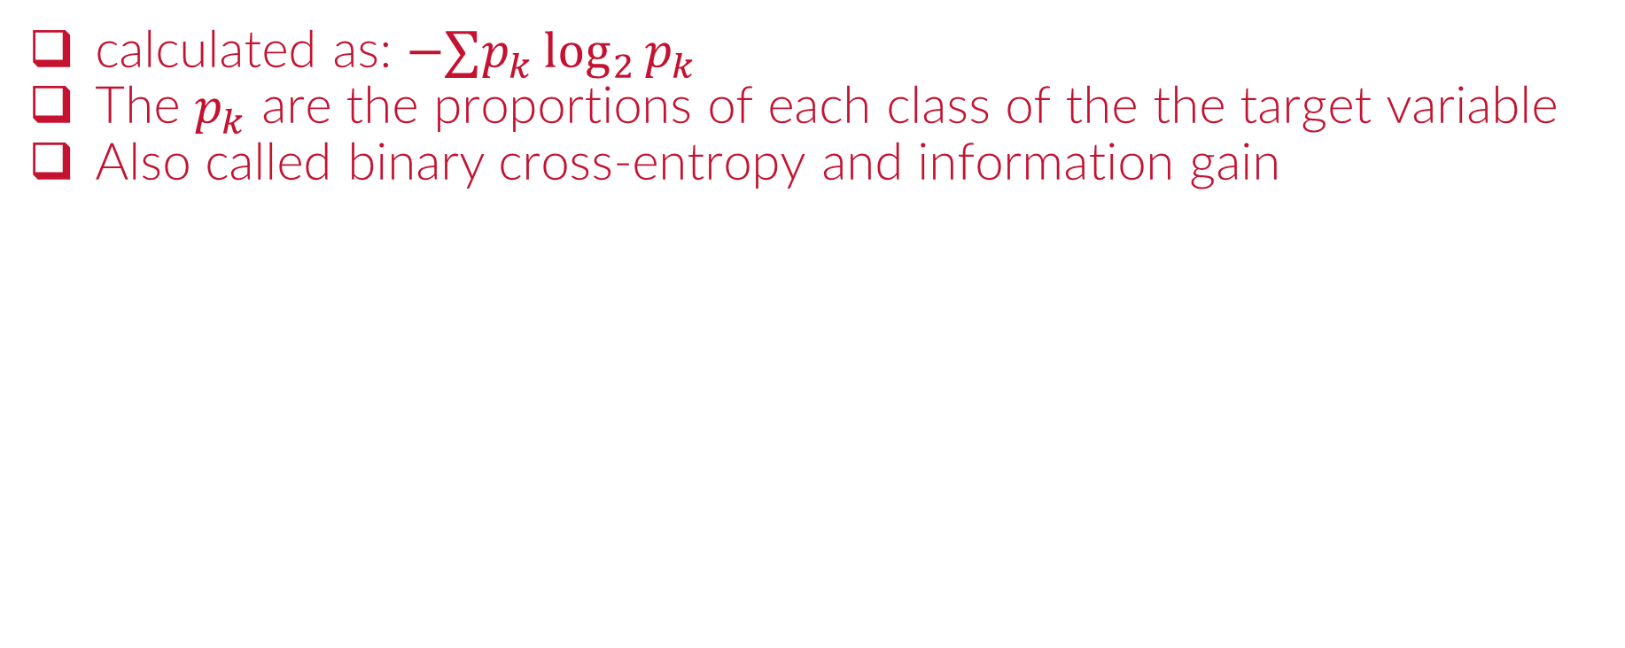
The Entropy (Classification)
calculated as: $−∑p_{k}\log_{2}{p_{k}}$
The $p_{k}$ are the proportions of each class of the the target variable
Also called binary cross-entropy and information gain

Slide 45
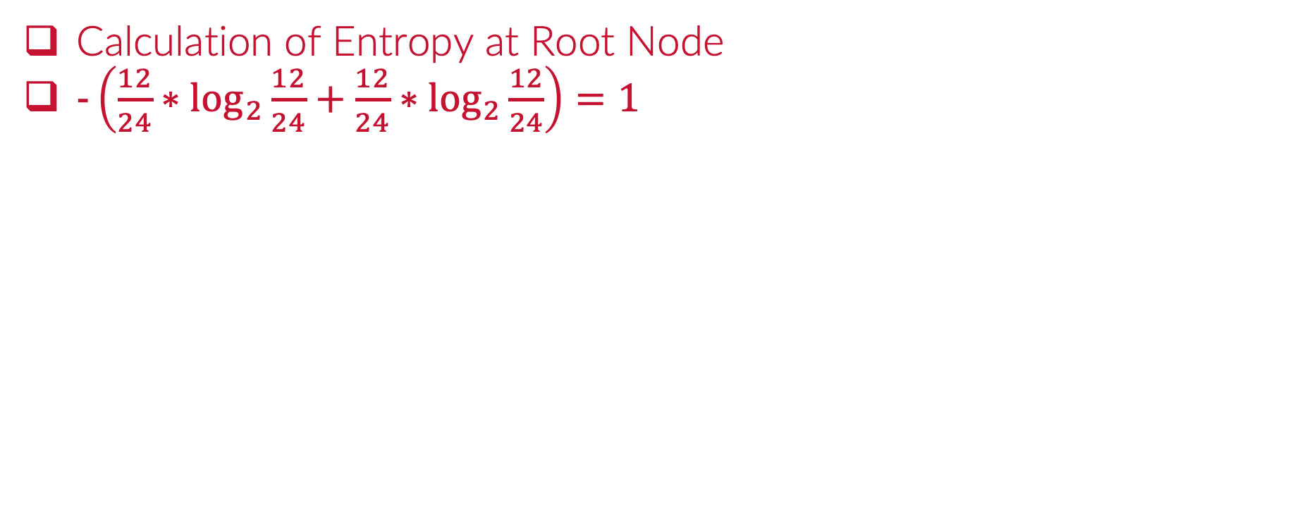
The Entropy (Root Node)
Calculation of Entropy at Root Node
$−\left(\frac{12}{24}∗\log_{2}{\frac{12}{24}}+\frac{12}{24}∗\log_{2}{\frac{12}{24}}\right)=1$

Slide 46
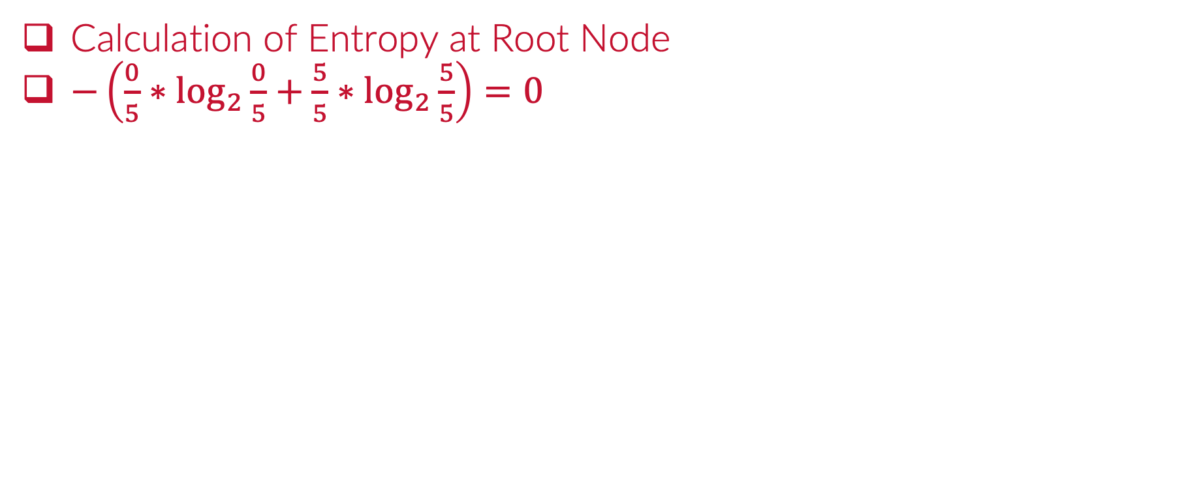
The Entropy (at Right Node)
Calculation of Entropy at Root Node
$−\left(\frac{0}{5}∗\log_{2}{\frac{0}{5}}+\frac{5}{5}∗\log_{2}{\frac{5}{5}}\right)=0$

Slide 47
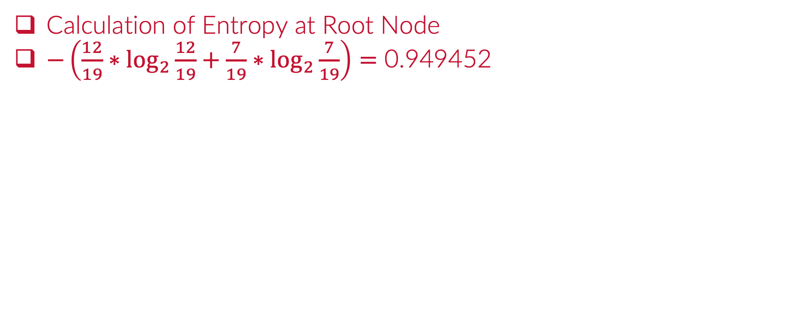
The Entropy (at Left Node)
Calculation of Entropy at Root Node
$−\left(\frac{12}{19}∗\log_{2}{\frac{12}{19}}+\frac{7}{19}∗\log_{2}{\frac{7}{19}}\right)=\text{0.949452}$

Slide 48
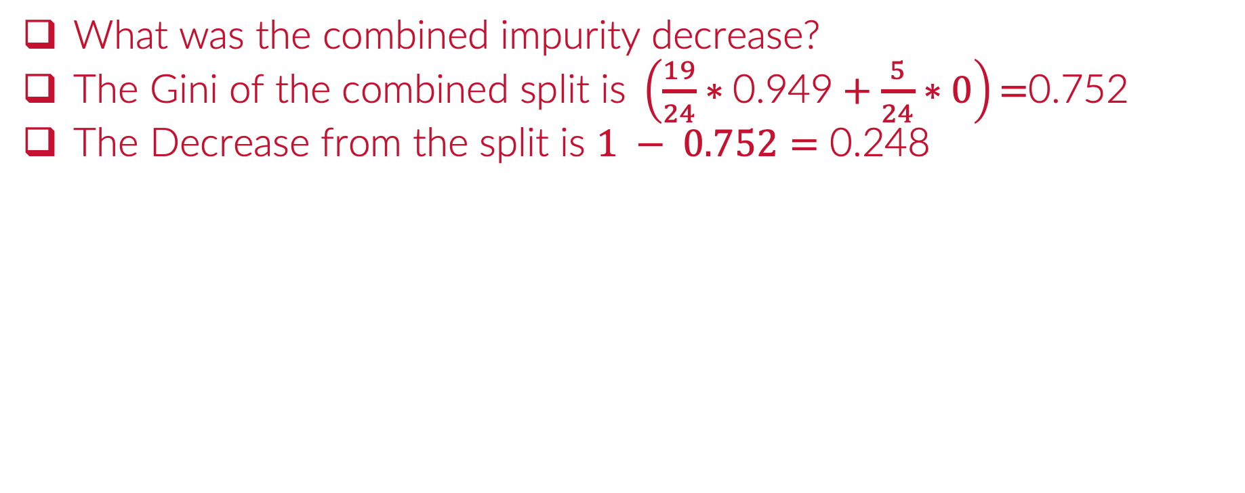
The Entropy (Combined Split)
$\text{What} \text{was} \text{the} \text{combined} \text{impurity} \text{decrease}\text{?}$
$\text{The} \text{Gini} \text{of} \text{the} \text{combined} \text{split} \text{is} \left(\frac{19}{24}∗\text{0.949}+\frac{5}{24}∗0\right)\text{=}\text{0.75}\text{2 }$
$\text{The} \text{Decrease} \text{from} \text{the} \text{split} \text{is} 1 − 0.752=\text{0.248}$

Slide 49
The Entropy Split
The Entropy is computed at each node for ALL possible splits
The split with best impurity decrease is chosen
$$Entropy Improvement 0.248$$

Slide 50
Python
Notes:
Guidelines
Use a title slide at the beginning of your presentation. There are 9 variations of title slides to choose from.
If you will have a series of slideshows, we recommend using the same style of title slide for each presentation.
Keep your title to no more than 2 lines.
Do not change the font style or font size of the title or subtitle.

Slide 51
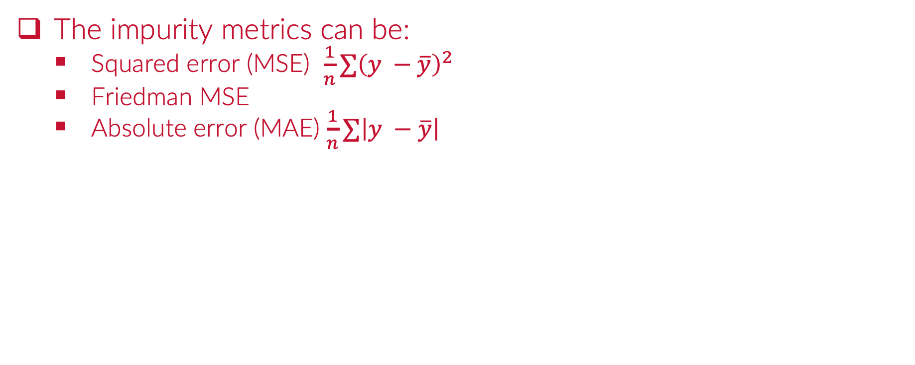
Regression Trees
The impurity metrics can be:
Squared error (MSE) $\frac{1}{n}∑{\left(y −\overline{y}\right)}^{2}$
Friedman MSE
Absolute error (MAE) $\frac{1}{n}∑\left|y −\overline{y}\right|$
1) IF (X1 = 1) AND X2 <= 20 THEN prediction = 0.33
2) IF (X2 = 1) AND (X2 > 20) THEN prediction = 0.55
3) IF (X2 = 2) THEN prediction = 0.82

Slide 52
Python
Notes:
Guidelines
Use a title slide at the beginning of your presentation. There are 9 variations of title slides to choose from.
If you will have a series of slideshows, we recommend using the same style of title slide for each presentation.
Keep your title to no more than 2 lines.
Do not change the font style or font size of the title or subtitle.

